Slide 1
Crop prediction System

Slide 2
Group Number : 12 shraddha panchal [TL] 102 chakradhar karhale 037 pravin patange 061

Slide 3
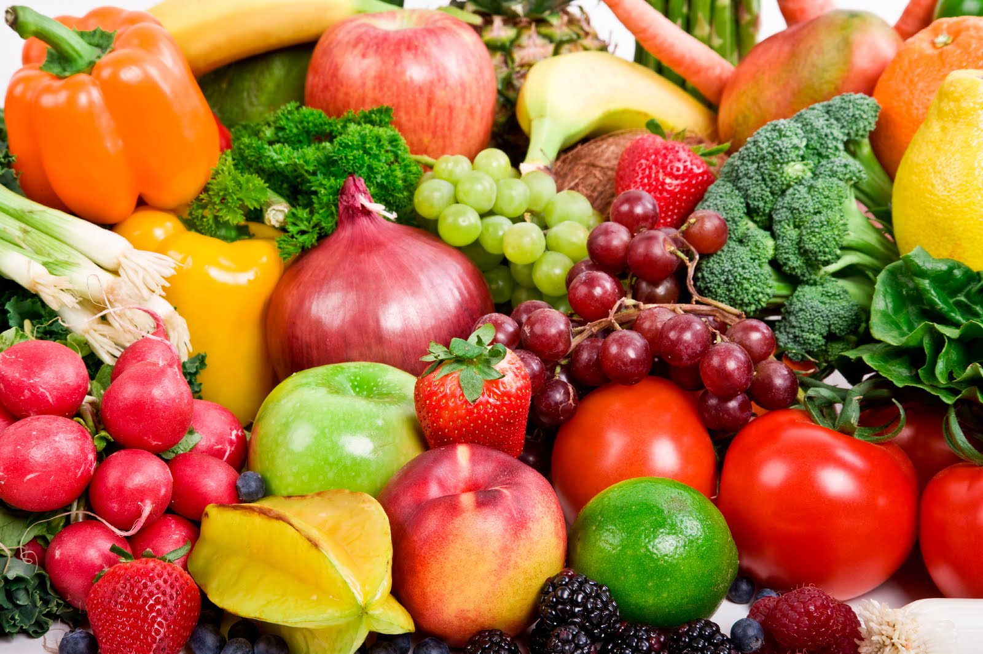
Introduction
Every individual is dependent on our Farmers.
Thus Farming is back-bone of India.
It’s the right of every farmers to get appropriate price.
It becomes important to design a system where:
Tracking of cultivated crop can be done.
Availability of particular crop in future should be predicted.
Tracing of transaction of farmer with wholesaler.
The wholesaler on other hand has to mentioned the name and identity of his customer (retailers) who is buying his product in huge amount.

Slide 4
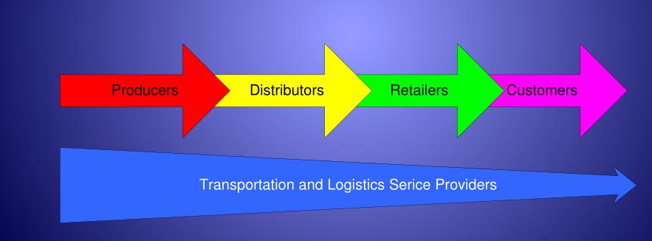
Problem Statement
Farmers get paid less due to:
Pressurized from the wholesaler for lesser amount
Large Availability of particular stock in market
No direct help from Govt. representative whenever needed
Most of Farmers not having idea about selling price of their cultivated products
Supply Chain Diagram

Slide 5
Problem statement
Farmers runs towards huge losses as they cannot predict:
Which crop to be cultivated
Financial loss due to low rates in market for a particular crop
Exact weather condition from Govt. Agencies

Slide 6
Flow for solution

Slide 7
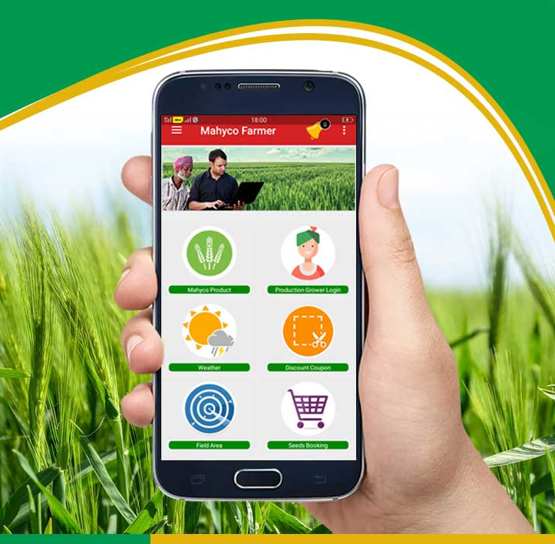
solution
Defining a centralized system consisting
Farmers Section
Buyers Section
Considering this system will be easy to use and will prove beneficial for farmers.

Slide 8
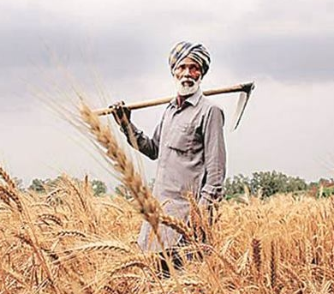
solution
Farmer’s Section:
A farmer will just need to specify about what he is going to cultivate on his land.
The data will be stored on system and will be use for analysis of the stock in market.
Data should not be fake as it going to affect their production
Thus this data of:
Amount of product sold to wholesaler will to calculated by the system to get an appropriate assumption of stock in market depending upon last year analysis.
India’s annual food consumption increases by 4%

Slide 9
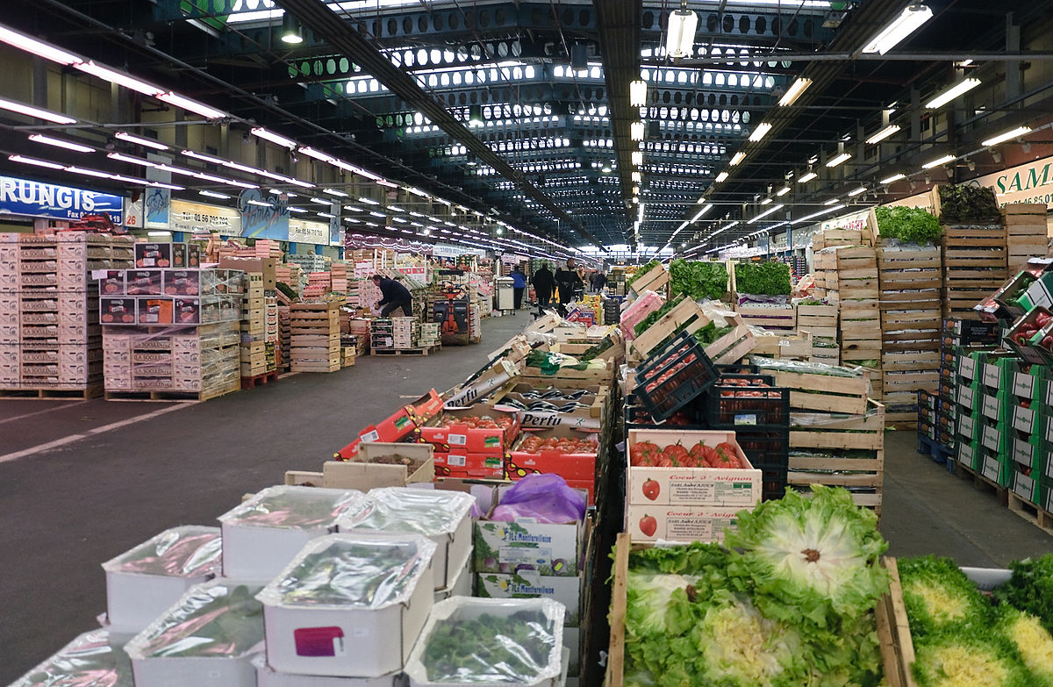
solution
Buyers Section:
After logging in the wholesaler will be able to update product information along with the amount.
Thus every specified amount of product would be sold to retailers having registration number.
Thus it will be easy to track the transaction between them.

Slide 10
Future Scope
The project has a very vast scope in future. The project can be implemented on intranet in future. Project can be updated in near future as and when requirement for the same arises, as it is very flexible in terms of expansion.
- With the proposed software of database Space Manager ready and fully functional the client is now able to manage and hence run the entire work in a much better, accurate and error free manner.
- The following are the future scope for the project.
1) Discontinue of particular farmer or buyer will eliminate total potential of system so can be included in Government system
2) Bar code Reader based sale system of food grains.
3) Individual Authentication system with photo ID for login of Farmer module and Buyer module login.
4) Can be shifted to mobile website

Slide 11
Roles and tables
Crops Tracking

Slide 12
Table of Farmers (Input taken from farmers)
FID
First Name
Last Name
Contact
Crop Info
Town
Water Source
Repo Crop
Quantity
Farm/Land info
e-mail
Login Id and password

Slide 13
Table for Buyer (Inputs Taken From buyer)
First Name
Last Name
e-mail
Login-Id and password

Slide 14
Table for Admin
First Name
Last Name
Admin-Id
e-mail
Login-ID and password

Slide 15
Output Table for Farmers
Product name
Quantity of availability in market
Current Price
Prediction of future Production/Availability
Prediction of Minimum price

Slide 16
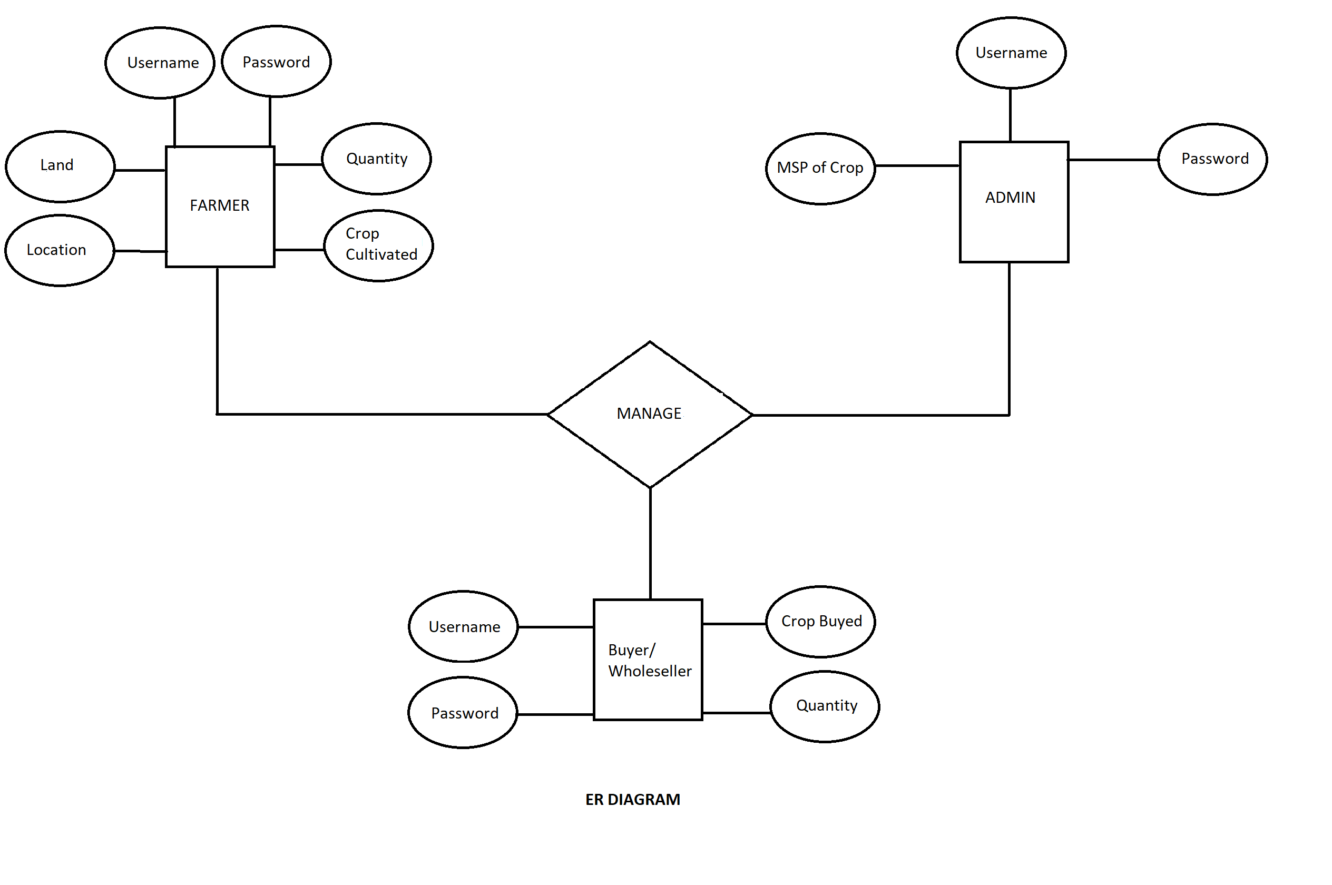
E.R.Diagram

Slide 17
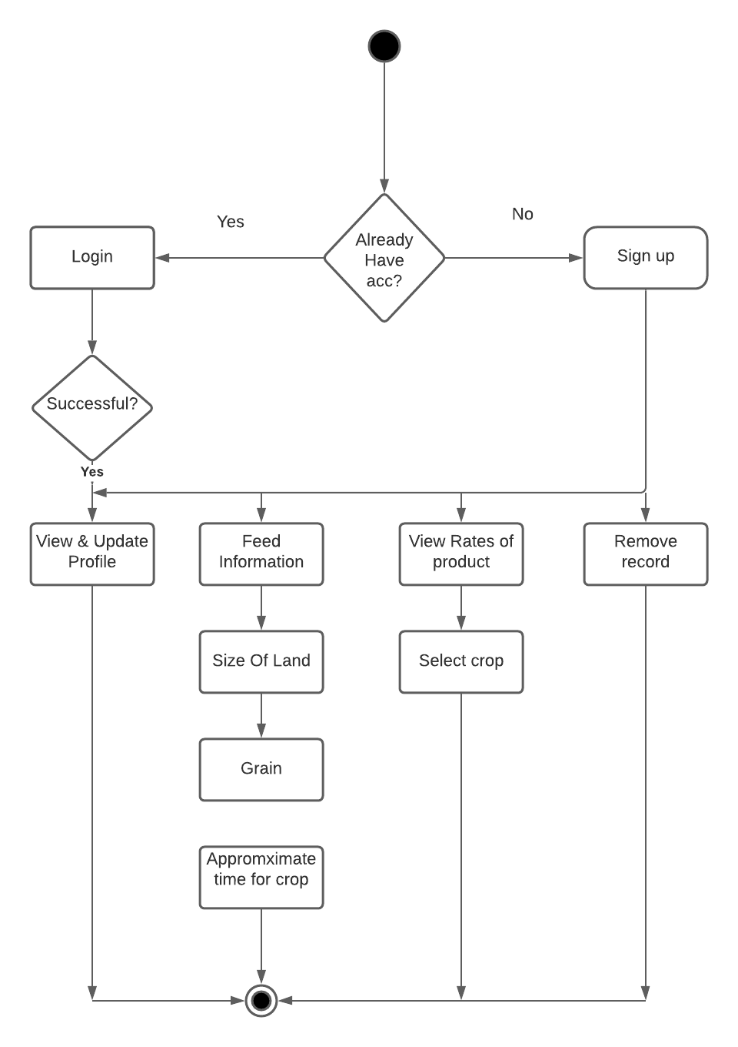
Activity diagram

Slide 18
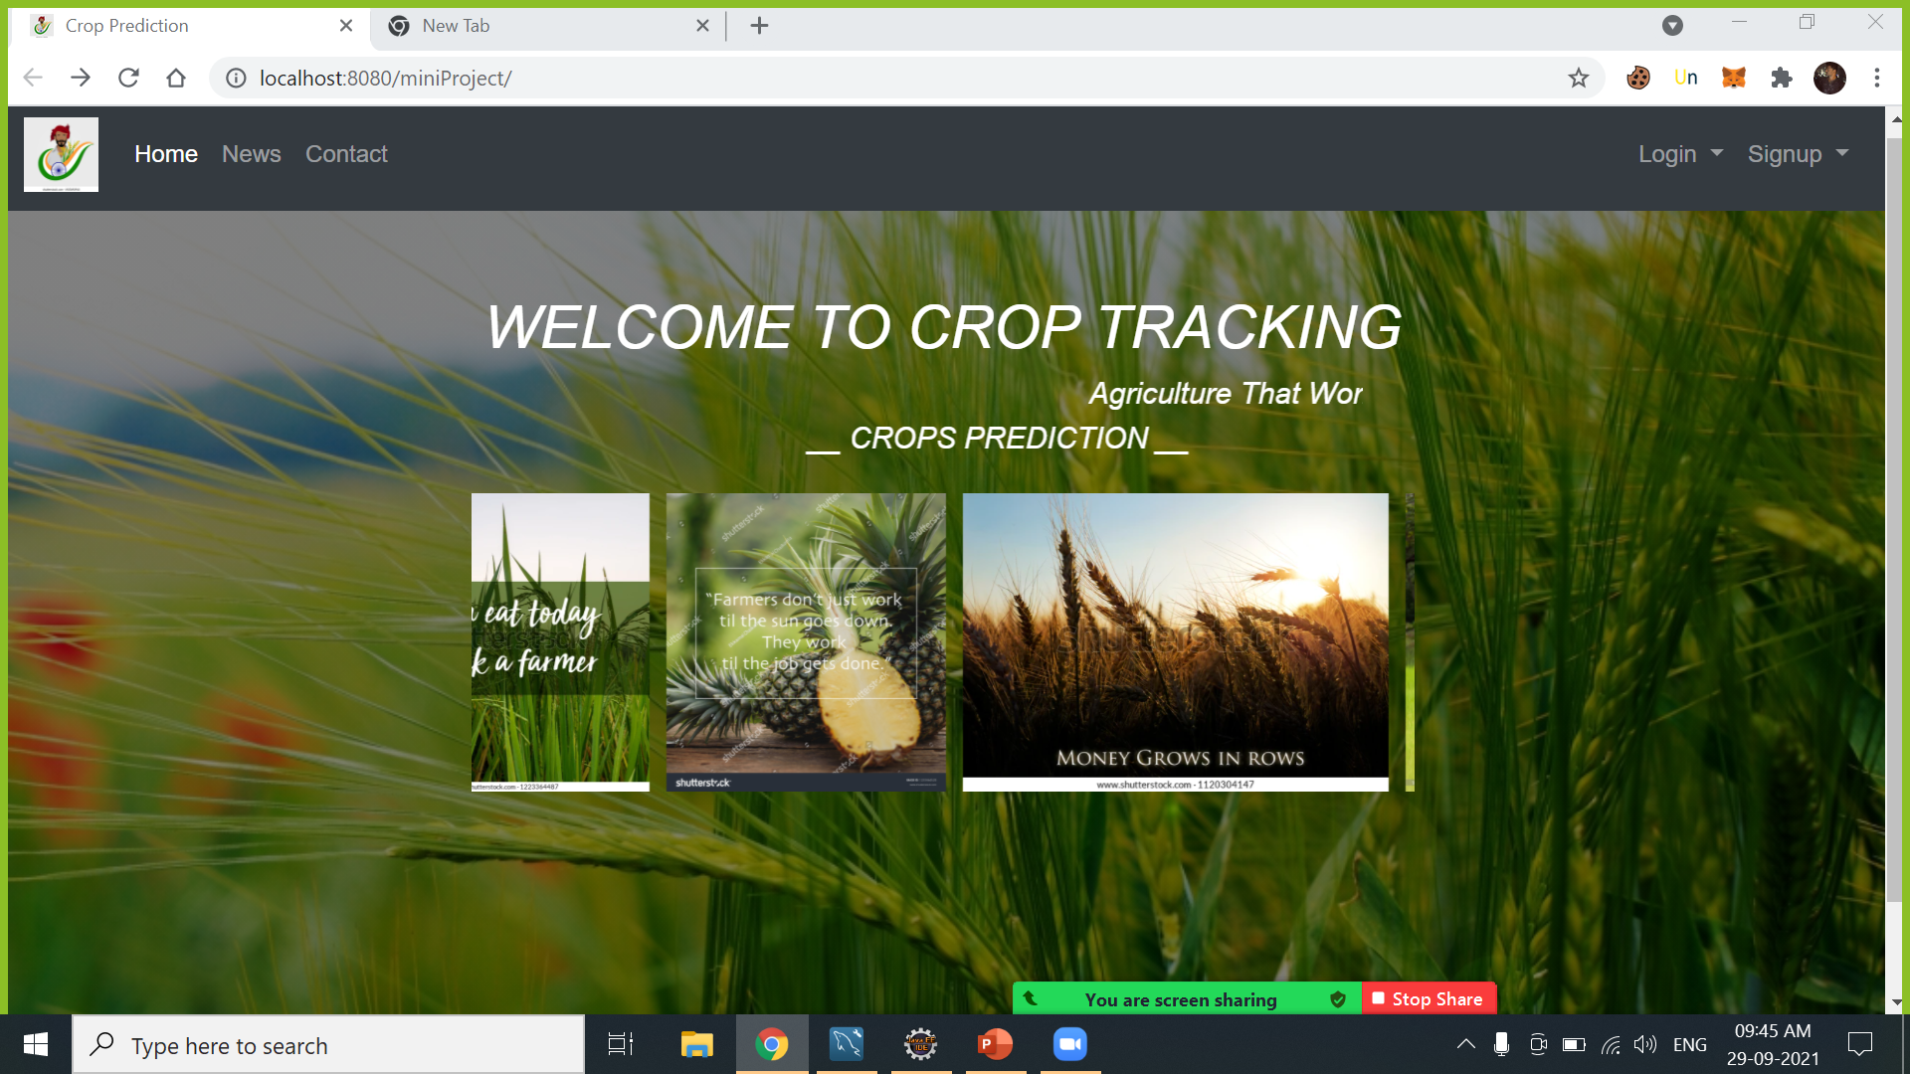

Slide 19
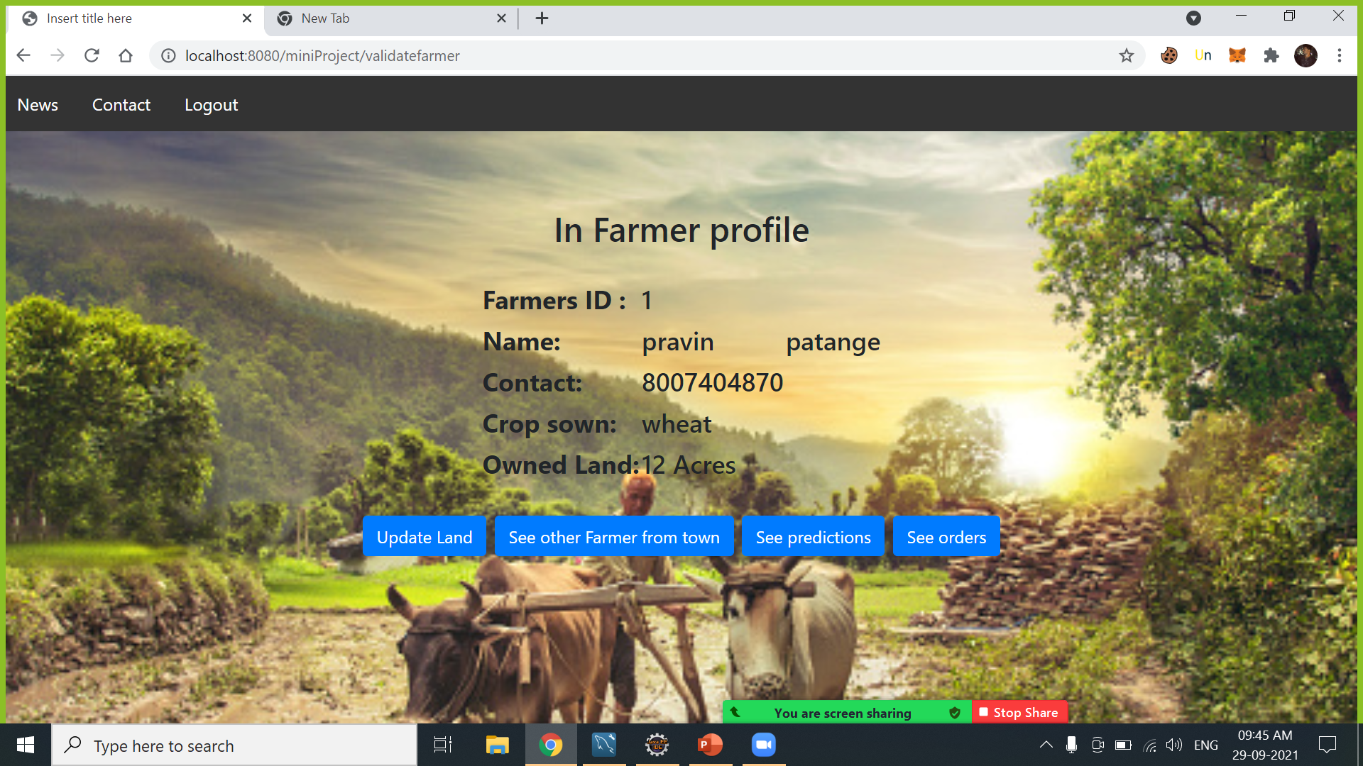

Slide 20
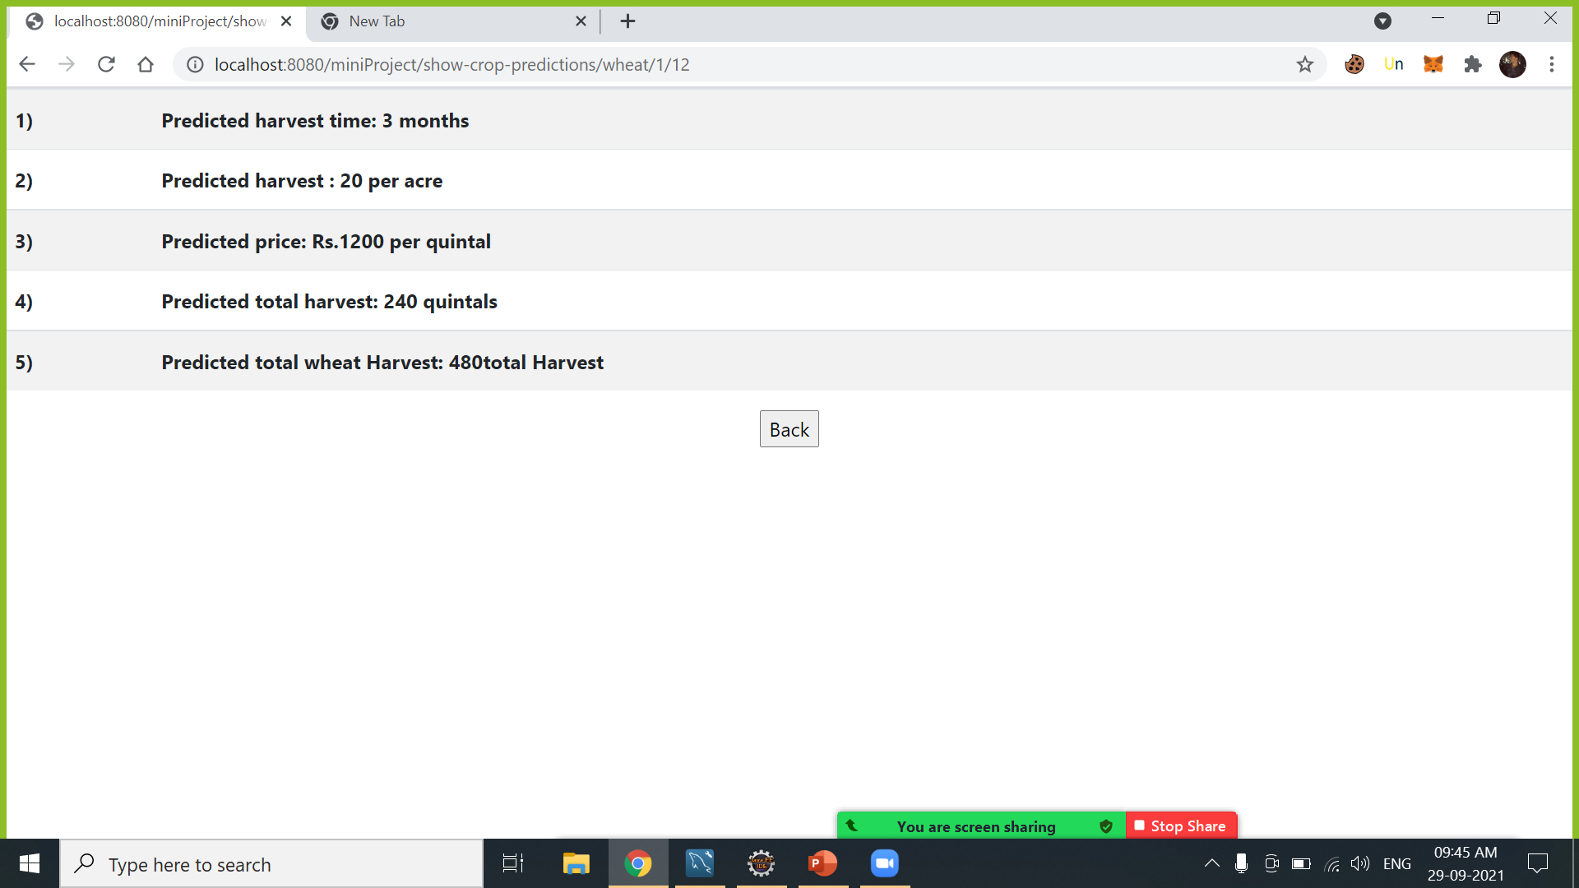

Slide 21
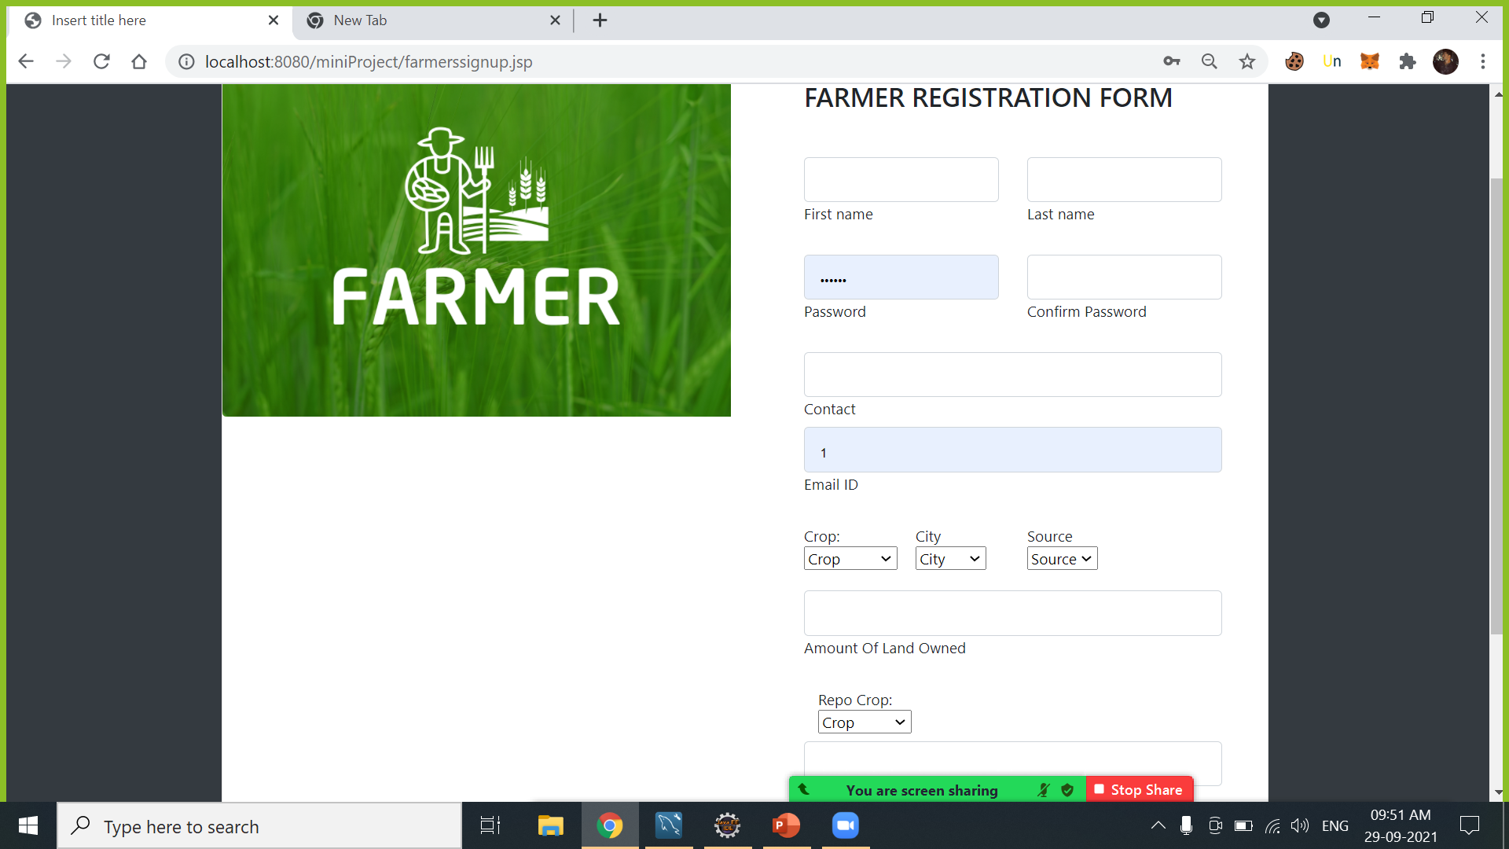

Slide 22
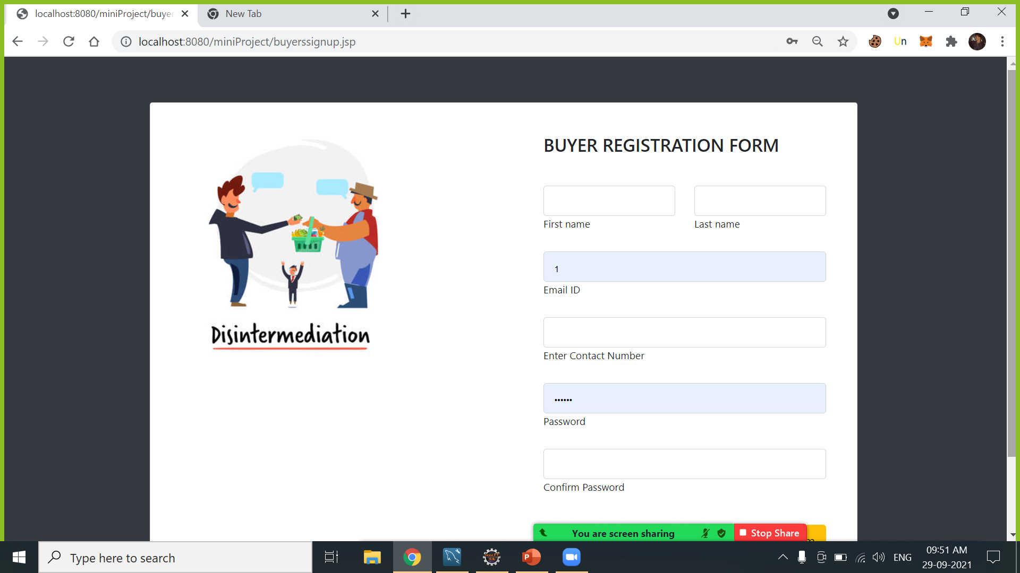

Slide 23
Thank You

